Slide 1
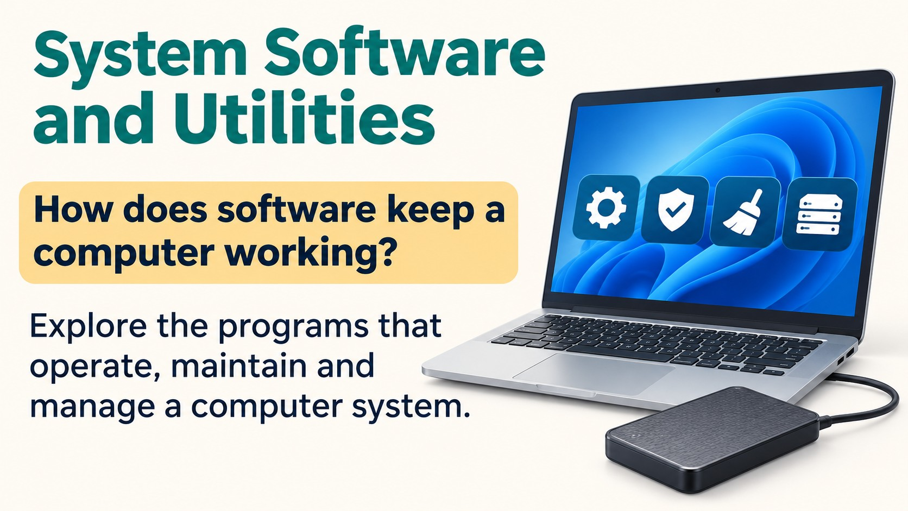
Notes:
Source: Pearson Edexcel International GCSE (9–1) ICT reference PDF. Chapter 2, printed pages 42–49 and 52. Classroom adaptation of approved content. Illustrations generated for this presentation and do not represent exact software interfaces.

Slide 2
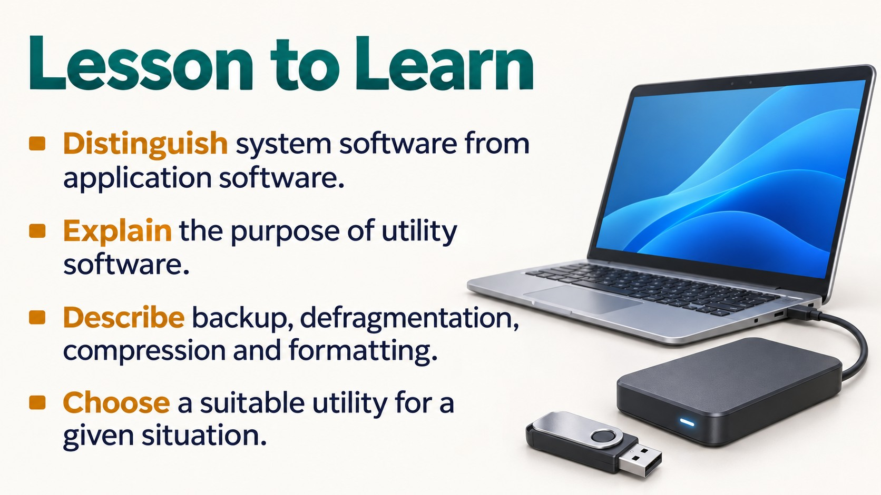
Notes:
Source: Pearson Edexcel International GCSE (9–1) ICT reference PDF. Chapter 2, printed pages 42–49 and 52. Classroom adaptation of approved content. Illustrations generated for this presentation and do not represent exact software interfaces.

Slide 3
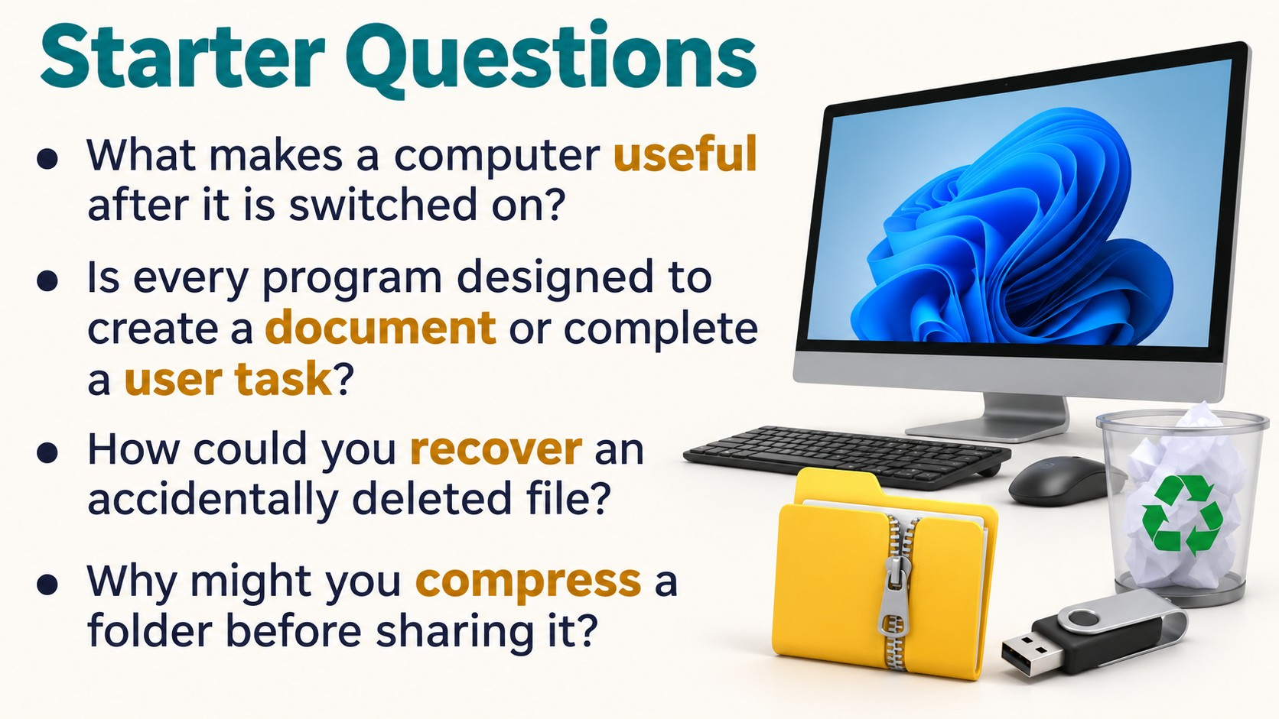
Notes:
Source: Pearson Edexcel International GCSE (9–1) ICT reference PDF. Chapter 2, printed pages 42–49 and 52. Classroom adaptation of approved content. Illustrations generated for this presentation and do not represent exact software interfaces.

Slide 4
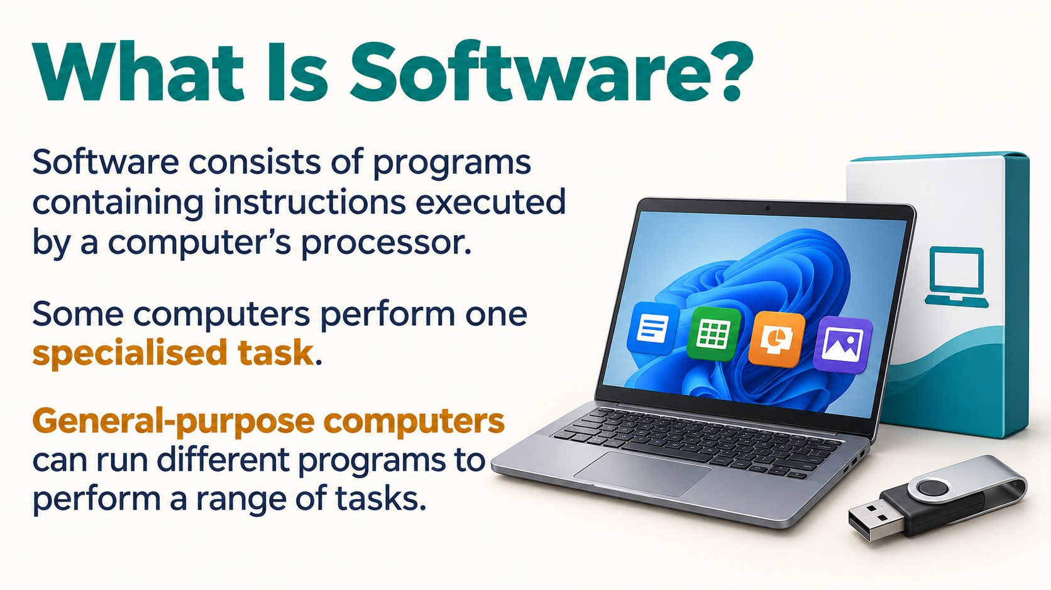
Notes:
Source: Pearson Edexcel International GCSE (9–1) ICT reference PDF. Chapter 2, printed pages 42–49 and 52. Classroom adaptation of approved content. Illustrations generated for this presentation and do not represent exact software interfaces.

Slide 5
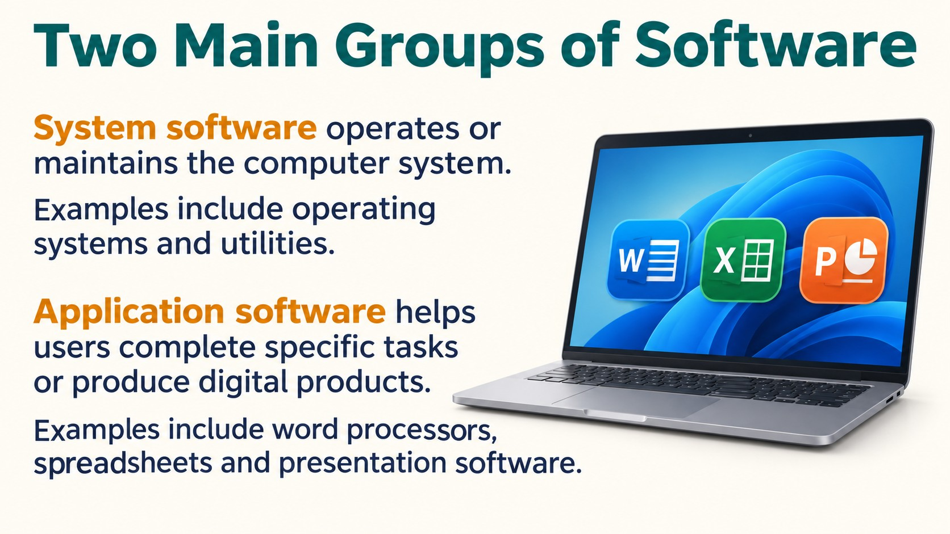
Notes:
Source: Pearson Edexcel International GCSE (9–1) ICT reference PDF. Chapter 2, printed pages 42–49 and 52. Classroom adaptation of approved content. Illustrations generated for this presentation and do not represent exact software interfaces.

Slide 6
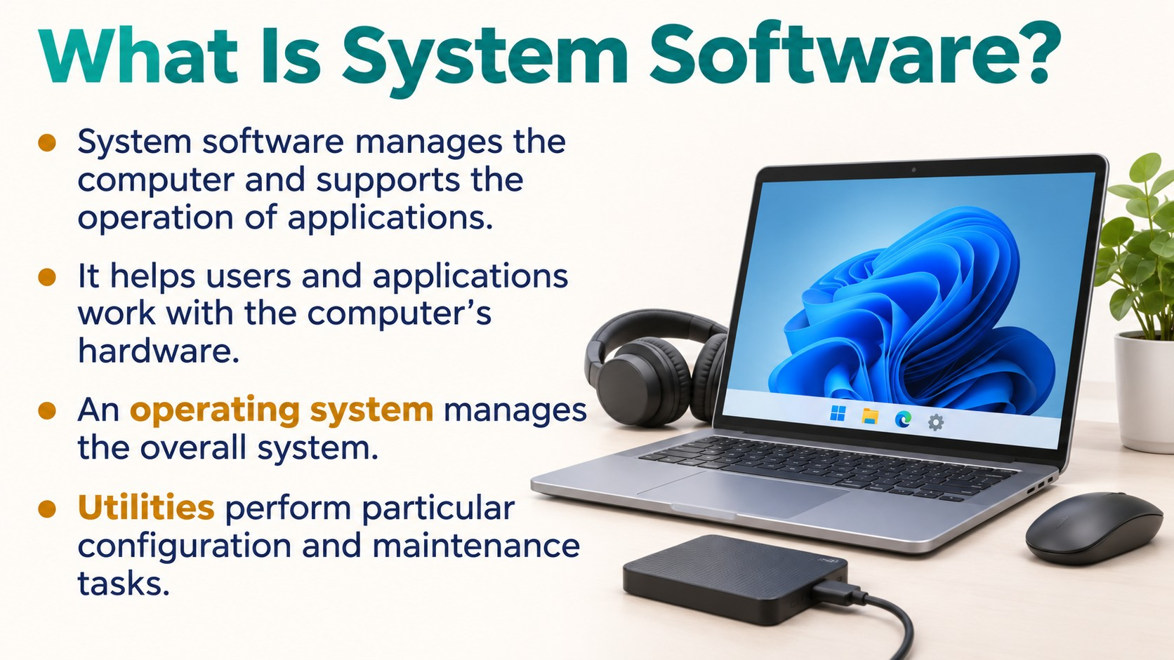
Notes:
Source: Pearson Edexcel International GCSE (9–1) ICT reference PDF. Chapter 2, printed pages 42–49 and 52. Classroom adaptation of approved content. Illustrations generated for this presentation and do not represent exact software interfaces.

Slide 7
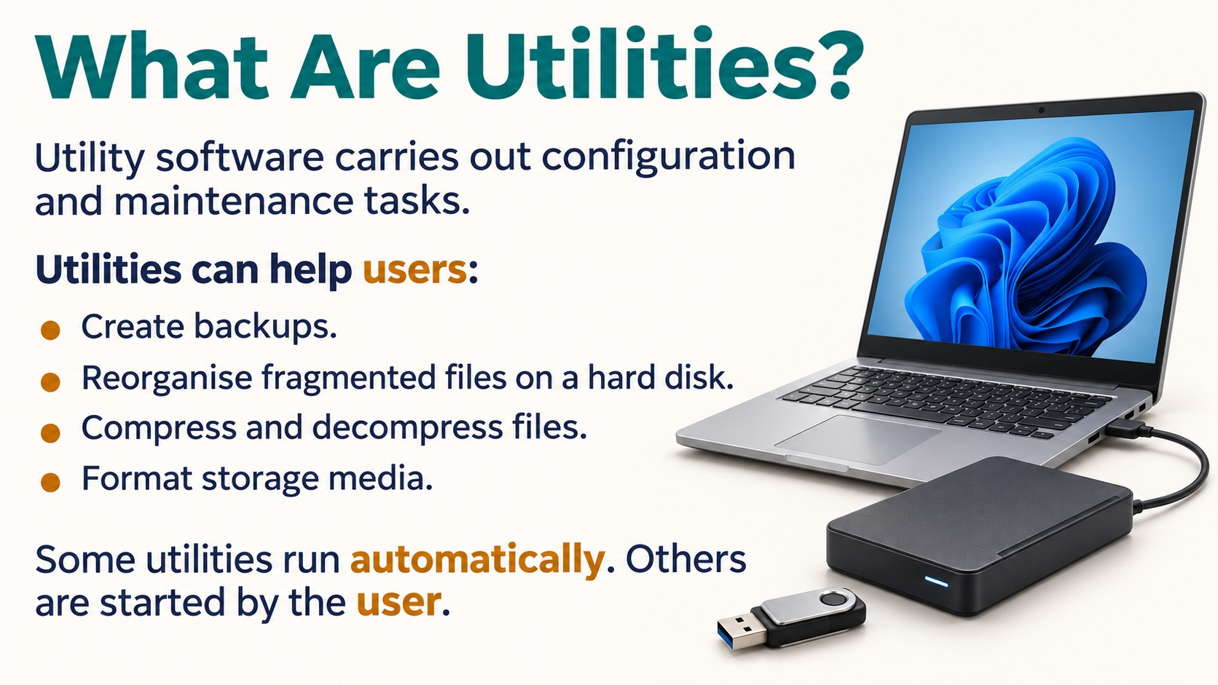
Notes:
Source: Pearson Edexcel International GCSE (9–1) ICT reference PDF. Chapter 2, printed pages 42–49 and 52. Classroom adaptation of approved content. Illustrations generated for this presentation and do not represent exact software interfaces.

Slide 8

Notes:
Source: Pearson Edexcel International GCSE (9–1) ICT reference PDF. Chapter 2, printed pages 42–49 and 52. Classroom adaptation of approved content. Illustrations generated for this presentation and do not represent exact software interfaces.

Slide 9
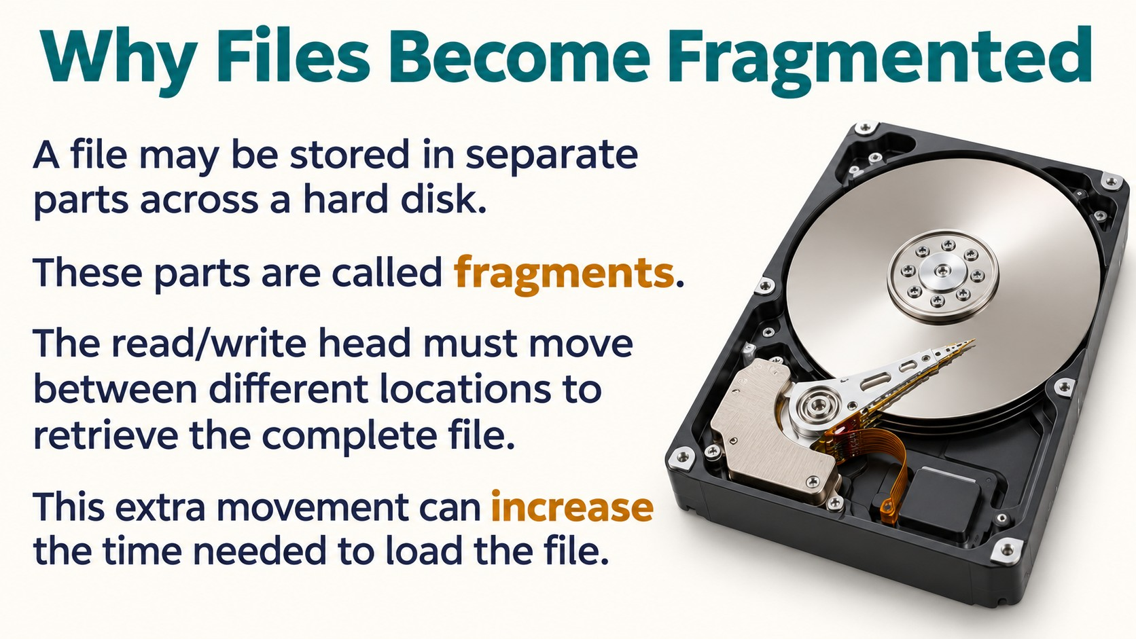
Notes:
Source: Pearson Edexcel International GCSE (9–1) ICT reference PDF. Chapter 2, printed pages 42–49 and 52. Classroom adaptation of approved content. Illustrations generated for this presentation and do not represent exact software interfaces.

Slide 10
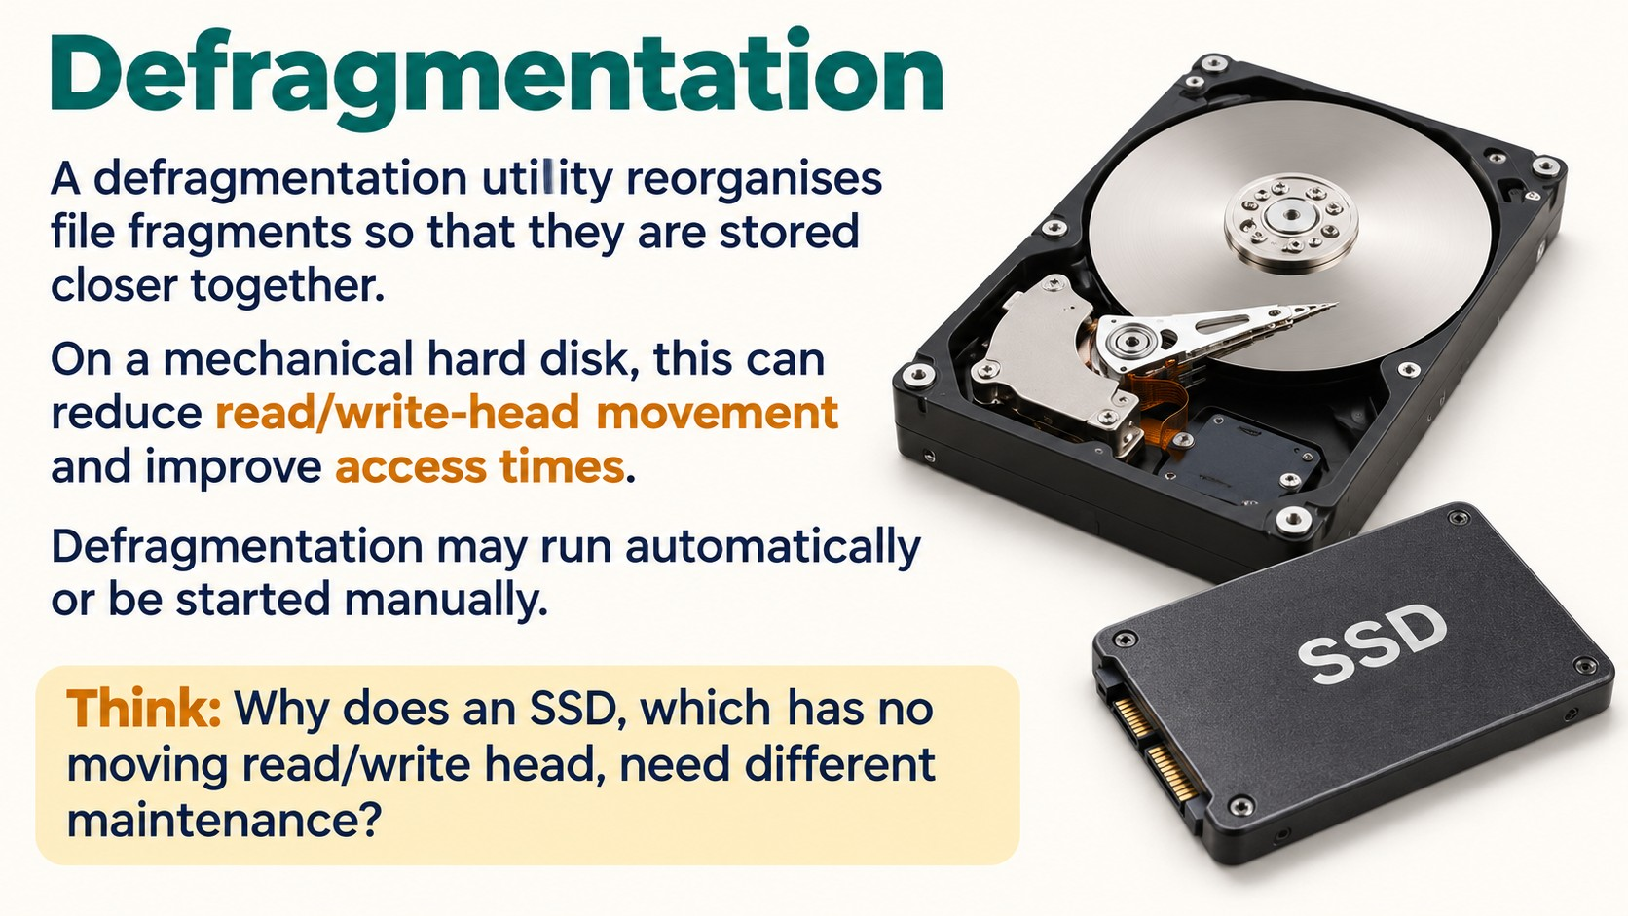
Notes:
Source: Pearson Edexcel International GCSE (9–1) ICT reference PDF. Chapter 2, printed pages 42–49 and 52. Classroom adaptation of approved content. Illustrations generated for this presentation and do not represent exact software interfaces.

Slide 11
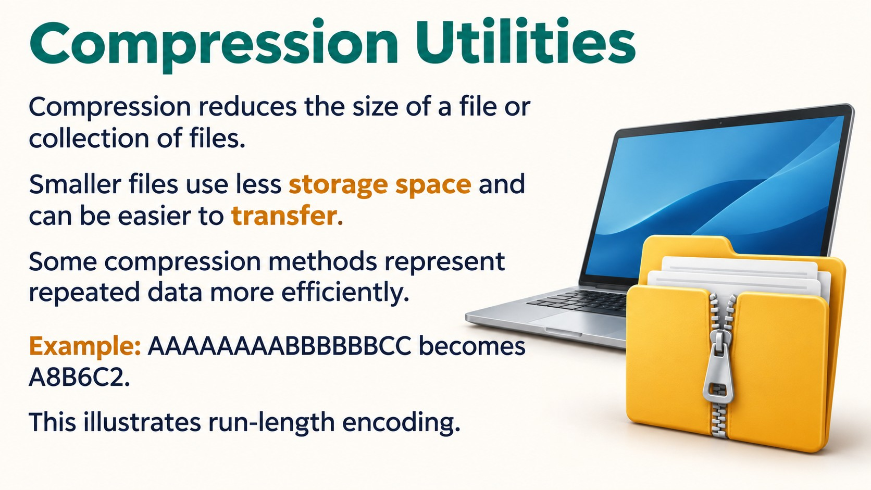
Notes:
Source: Pearson Edexcel International GCSE (9–1) ICT reference PDF. Chapter 2, printed pages 42–49 and 52. Classroom adaptation of approved content. Illustrations generated for this presentation and do not represent exact software interfaces.

Slide 12
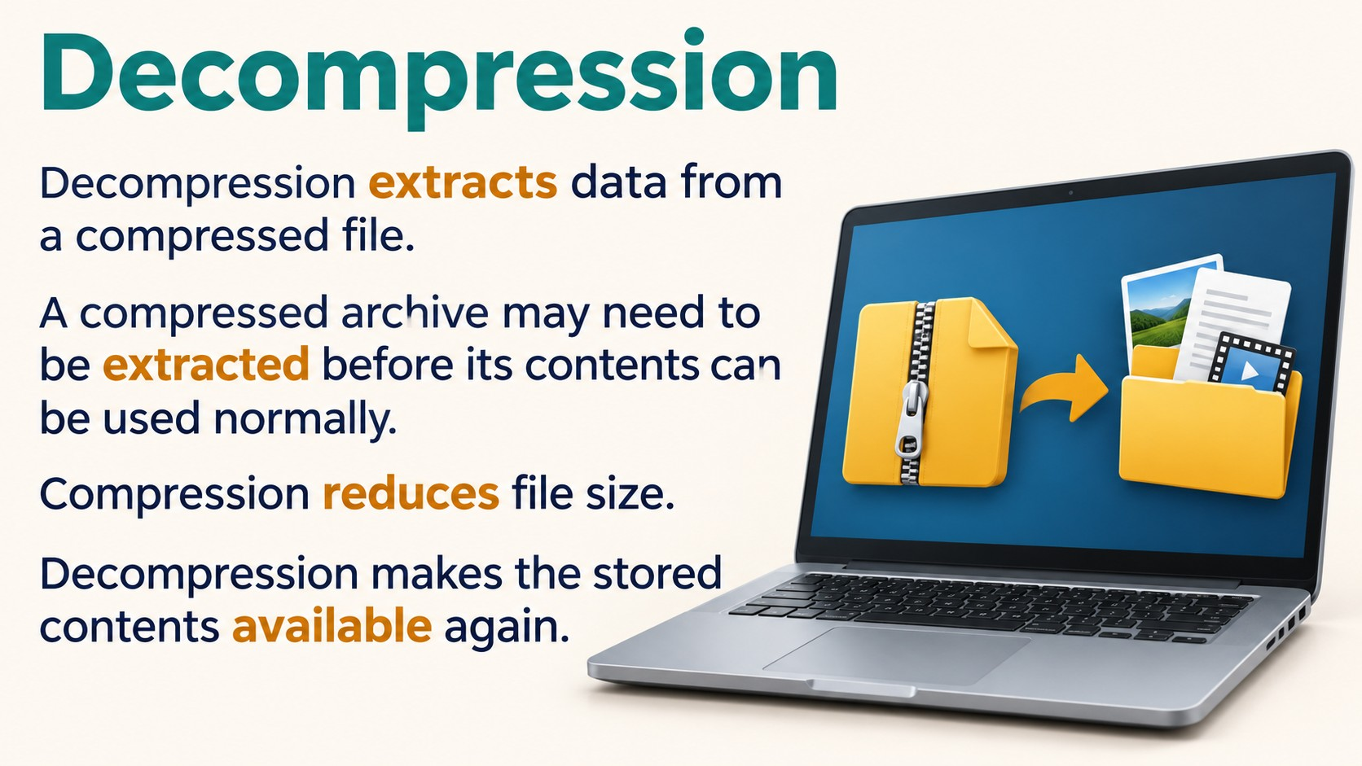
Notes:
Source: Pearson Edexcel International GCSE (9–1) ICT reference PDF. Chapter 2, printed pages 42–49 and 52. Classroom adaptation of approved content. Illustrations generated for this presentation and do not represent exact software interfaces.

Slide 13
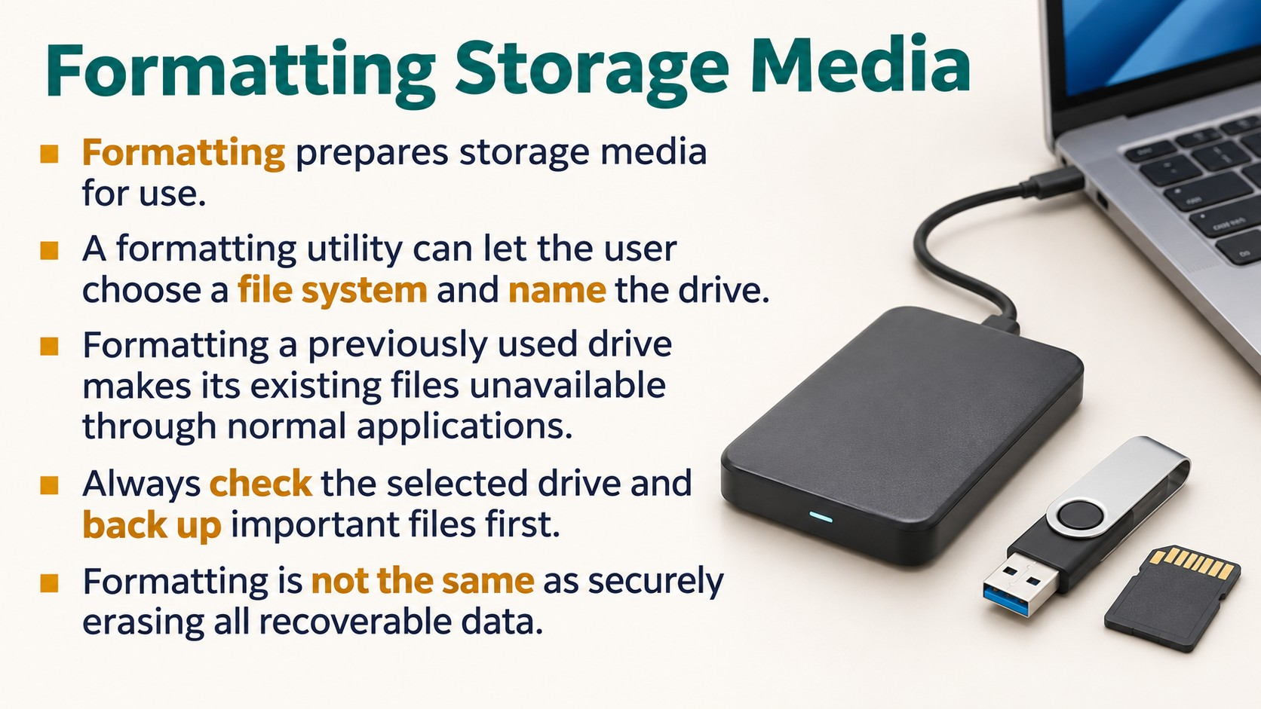
Notes:
Source: Pearson Edexcel International GCSE (9–1) ICT reference PDF. Chapter 2, printed pages 42–49 and 52. Classroom adaptation of approved content. Illustrations generated for this presentation and do not represent exact software interfaces.

Slide 14

Notes:
Source: Pearson Edexcel International GCSE (9–1) ICT reference PDF. Chapter 2, printed pages 42–49 and 52. Classroom adaptation of approved content. Illustrations generated for this presentation and do not represent exact software interfaces.

Slide 15
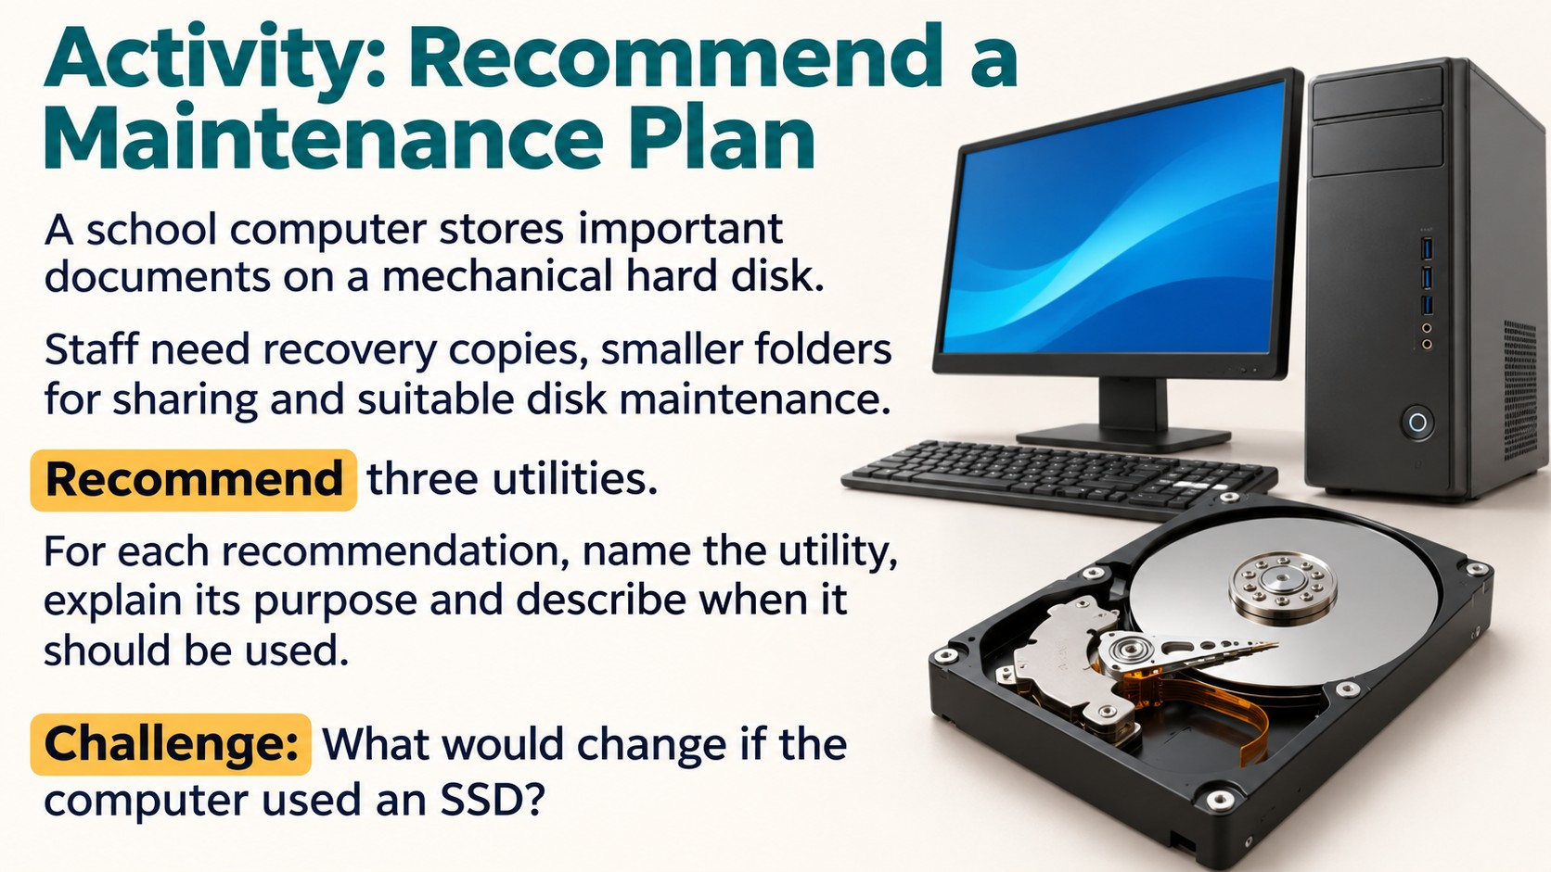
Notes:
Source: Pearson Edexcel International GCSE (9–1) ICT reference PDF. Chapter 2, printed pages 42–49 and 52. Classroom adaptation of approved content. Illustrations generated for this presentation and do not represent exact software interfaces.

Slide 16
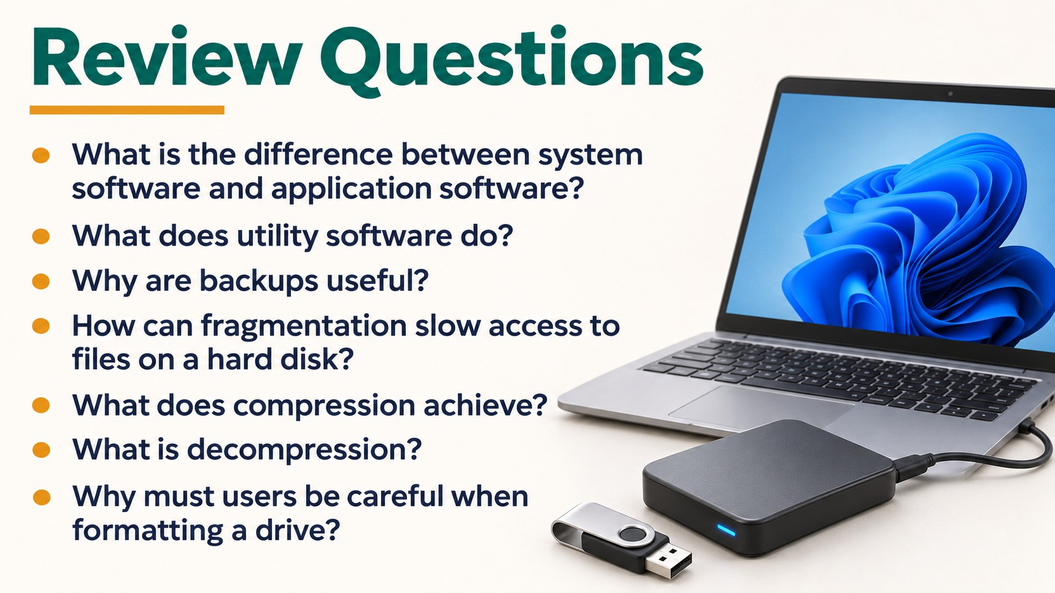
Notes:
Source: Pearson Edexcel International GCSE (9–1) ICT reference PDF. Chapter 2, printed pages 42–49 and 52. Classroom adaptation of approved content. Illustrations generated for this presentation and do not represent exact software interfaces.

